Slide 1

MittOS Supporting Millisecond Tail Tolerance with Fast Rejecting SLO-Aware OS Interface
Mingzhe Hao, Huaicheng Li, Michael Hao Tong,
Chrisma Pakha, Riza O. Suminto, Cesar A. Stuardo,
Andrew A. Chien, and Haryadi S. Gunawi
SOSP 2017

Slide 2
Outline
Introduction
Design
Evaluation
Conclusion

Slide 3
Outline
Introduction
Design
Evaluation
Conclusion

Slide 4





Millisecond Tail Latency
SLO: Software Level Objective
Parallel
task # 11
10ms
…
Parallel
task # 22
30ms
IO contention
Completion
30ms

Slide 5
Current Latency Mechanism
1. Speculation
2. Cloning
Introduces more than 2x workloads
Most popular
10ms
？？？
IO Contention!
Snitching
Monitor and pick fast replica
Does not work when burstiness fluctuates in ms-level
Wait
10ms
Completion
20ms+network-hop

Slide 6
Current Mechanism V.S New Mechanism
Wait
No Wait
My disk is busy!
Try elsewhere
Disk Queue
？？？
App
OS
Wait
ok
Fast reject
Failover (no-wait)
Completion
20ms + network-hop
Completion
10ms + network-hop

Slide 7
Use-Case
I want < 20ms latency
OS can see “everything” and tell app when it is busy
App
OS
1
SLO = 20ms
3
Disk Queue
2
ret = read(.., SLO)
EBUSY
if ( ret == Reject)
// failover
5
4
Reject fast

Slide 8
When can OS return?
Challenge
Chanllenge2: Performance
ret = read(..., < 20ms)
App
OS
Should I reject the IO?
?
Chanllenge1: Accuracy
What is the OS queue policy?
What is the device type?
FIFO, CFQ, elevator, etc.
Prediction depends on queue policy and device type

Slide 9
Outline
Background
Design
MittNOOP
MittCFQ
MittSSD
MittCache(skip)
Evaluation
Conclusion

Slide 10
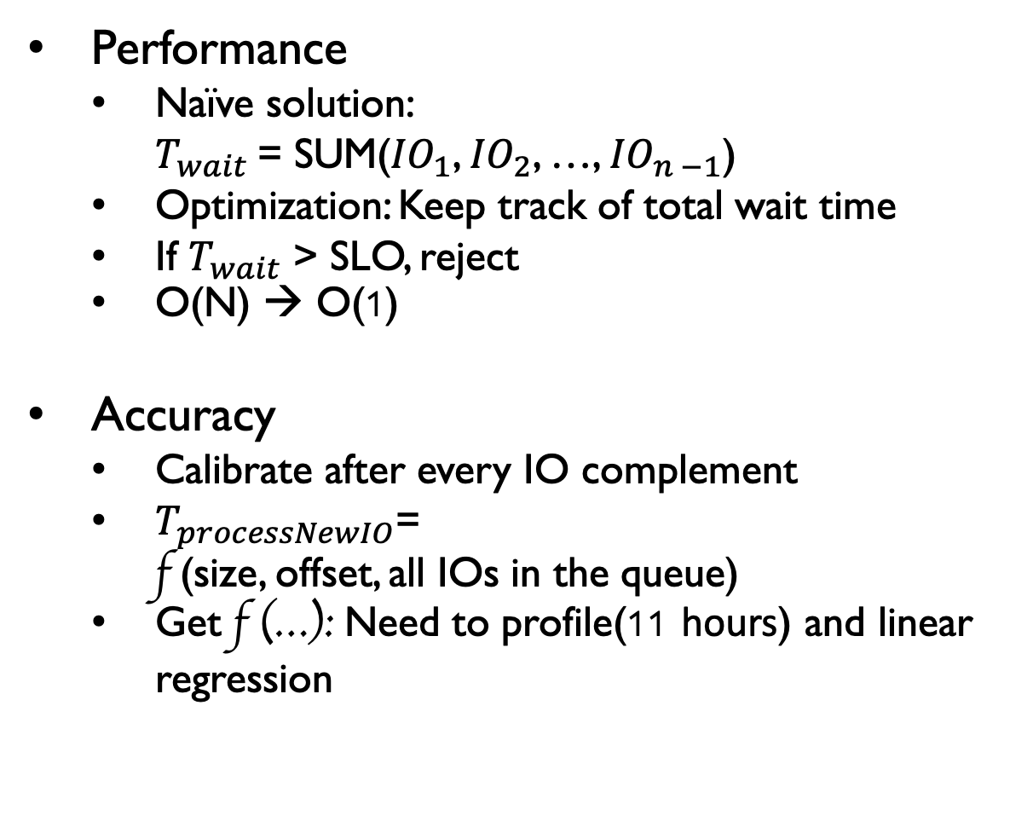
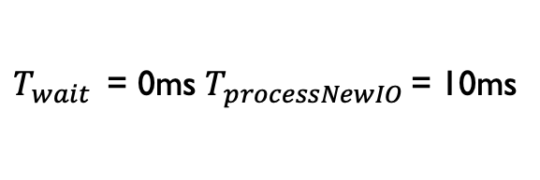
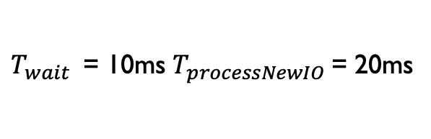
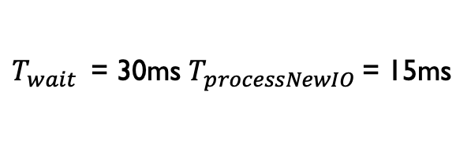
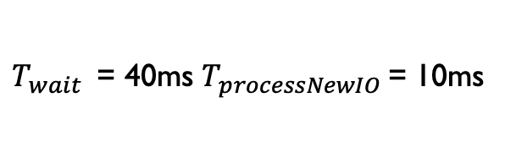
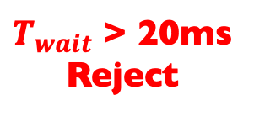
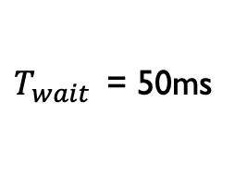
MittNOOP(FIFO)
App
SLO < 20ms
Performance
Naïve solution:
$T_{wait}$= SUM(${IO}_{1}$, ${IO}_{2}$, …, ${IO}_{n −1}$)
Optimization: Keep track of total wait time
If $T_{wait}$ > SLO, reject
O(N) → O(1)
Accuracy
Calibrate after every IO complement
$T_{processNewIO}$=
f (size, offset, all IOs in the queue)
Get f (…): Need to profile(11 hours) and linear regression
OS
$T_{wait}$ > 20ms
Reject
$T_{wait}$ = 50ms
OS FIFO Queue
$T_{wait}$ = 40ms $T_{processNewIO}$= 10ms
$T_{wait}$ = 30ms $T_{processNewIO}$= 15ms
$T_{wait}$ = 10ms $T_{processNewIO}$= 20ms
$T_{wait}$ = 0ms $T_{processNewIO}$= 10ms

Slide 11
MittCFQ(CFQ)
CFQ: Completely Fair Queuing
Time
Start
Slice1
Slice2
Slice3
…
Slice N
Group
1
Group
2
Group
3
…
Group
N
Time slice length is proportional to the group‘s weight.

Slide 12
MittCFQ(CFQ)
Every group has 7 trees.
Priority: RealTime > BestEffort > Idle
Group
RealTime
RealTime
Group
………
…
…
…
…
Group
…
…
Idle
BestEffort
…
………
………
…
…
…
…
…
…

Slide 13
MittCFQ(CFQ)
Node n(Process n)
G
Service Tree 1
IO request 1
IO request 4
1 process 1 node
G
IO request 2
…
…
…
…
G
IO request 3
…
…
…
Service Tree 2
Red-Black Tree
…
…
…

Slide 14
MittCFQ(CFQ)
CFQ Queue
Global FIFO Queue
Node 1(Process 1)
G
Service Tree
G
…
…
G
…
…
…
…
…
Service Tree 2
…
…
In the chosen tree, CFQ picks a node in round robin style.
…

Slide 15
MittCFQ(CFQ)
CFQ Queue
Global FIFO Queue
Node 2(Process 2)
G
Service Tree
G
…
…
…
…
G
…
…
…
Service Tree 2
…
…
In the chosen tree, CFQ picks a node in round robin style.
Some or all requests from the node will be put into FIFO queue.
…

Slide 16
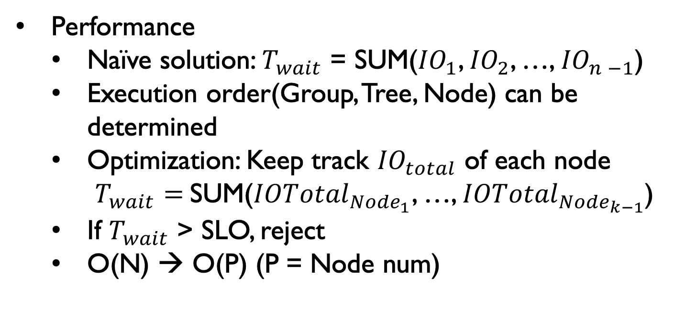
MittCFQ(CFQ)
IO request
Performance
Naïve solution: $T_{wait}$ = SUM(${IO}_{1}$, ${IO}_{2}$, …, ${IO}_{n −1}$)
Execution order(Group, Tree, Node) can be determined
Optimization: Keep track ${IO}_{total}$ of each node
$T_{wait}=$SUM(${IOTotal}_{{Node}_{1}}$, …, ${IOTotal}_{{Node}_{k−1}}$)
If $T_{wait}$ > SLO, reject
O(N) → O(P) (P = Node num)
Group
Determined!
Service Tree
Determined!
…
…
…
Node(Process)
Determined!
…
…
…

Slide 17
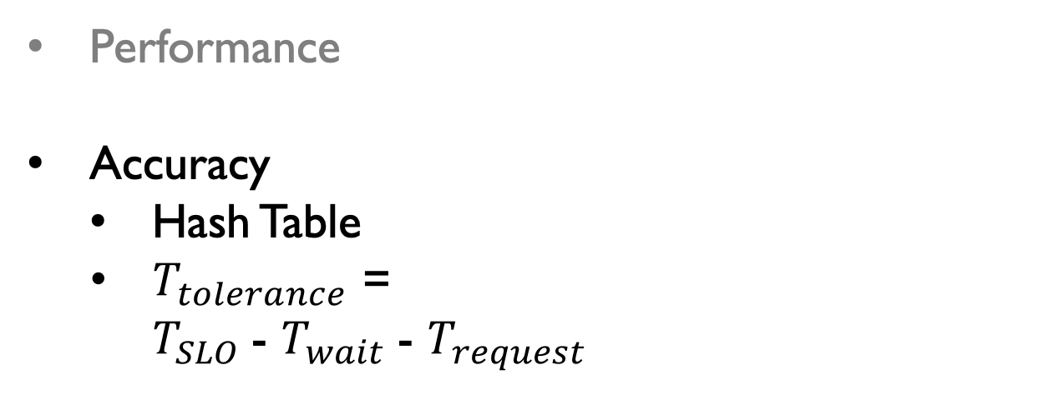
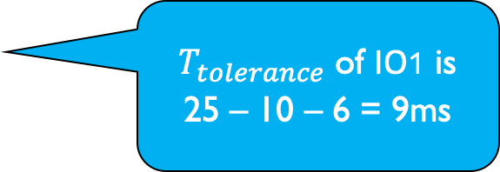
Key (Tolerance Time) | Value (IO ID)
… | …
9ms | …
… | …
3ms | …
… | …
MittCFQ
$T_{tolerance}$ of IO1 is
25 – 10 – 6 = 9ms
, IO1
Performance
Accuracy
Hash Table
$T_{tolerance}$ =
$T_{SLO}$- $T_{wait}$- $T_{request}$
IO1:
read(< 25ms,lowprior)
App
OS
IO1 need to wait 10ms
FIFO Queue
I need 6ms to complete
Simplified CFQ Queue

Slide 18
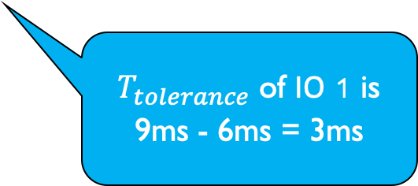
Key (Tolerance Time) | Value (IO ID)
… | …
9ms | …, IO1
… | …
3ms | …
… | …
MittCFQ
Performance
Accuracy
Hash Table
$T_{tolerance}$ =
$T_{SLO}$- $T_{wait}$- $T_{request}$
$T_{tolerance}$ of IO 1 is 9ms - 6ms = 3ms
, IO1
IO1:
read(< 25ms,lowprior)
IO2:
read(< 25ms,highprior)
App
OS
I need 6ms to complete
FIFO Queue
I have higher priority
Simplified CFQ Queue

Slide 19
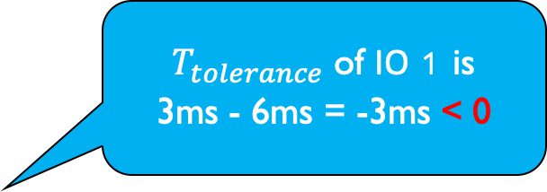
Key (Tolerance Time) | Value (IO ID)
… | …
9ms | …
… | …
3ms | …, IO1
… | …
MittCFQ
$T_{tolerance}$ of IO 1 is
3ms - 6ms = -3ms < 0
Performance
Accuracy
Hash Table
$T_{tolerance}$ =
$T_{SLO}$- $T_{wait}$- $T_{request}$
IO2:
read(< 25ms,highprior)
IO1:
read(< 25ms,lowprior)
IO3:
read(< 25ms,highprior)
App
OS
Reject
I have higher priority
FIFO Queue
Simplified CFQ Queue
I need 6ms to complete

Slide 20
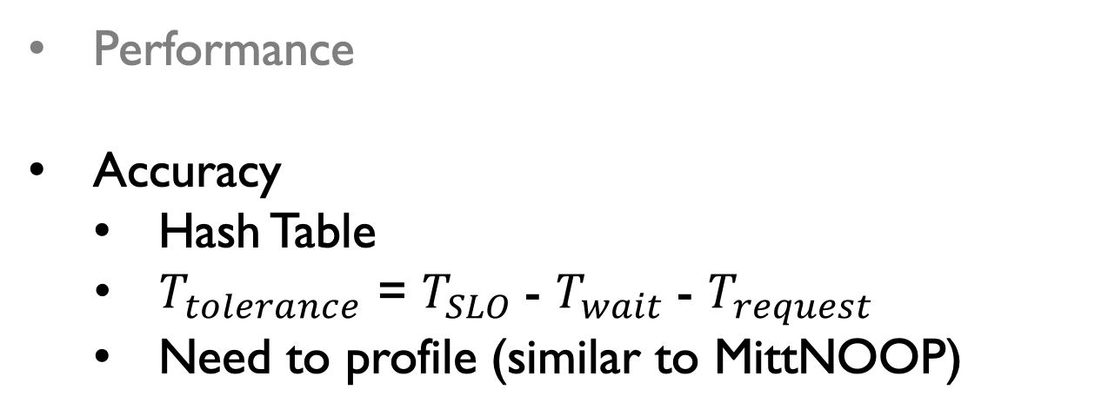
MittCFQ
Performance
Accuracy
Hash Table
$T_{tolerance}$ = $T_{SLO}$- $T_{wait}$- $T_{request}$
Need to profile (similar to MittNOOP)
OS:
How can I know this?
FIFO Queue
Simplified CFQ Queue
I need 6ms to complete

Slide 21
MittSSD
White-box knowledge
Commodity SSDs cannot satisfy
Host-managed/software-defined flash
FTL should be visible to OS!
OS needs to know where IOs are mapped
OS
FTL at host
GC
Fast!
Busy!
Open-Channel
SSD
OS need to capture all GCs

Slide 22
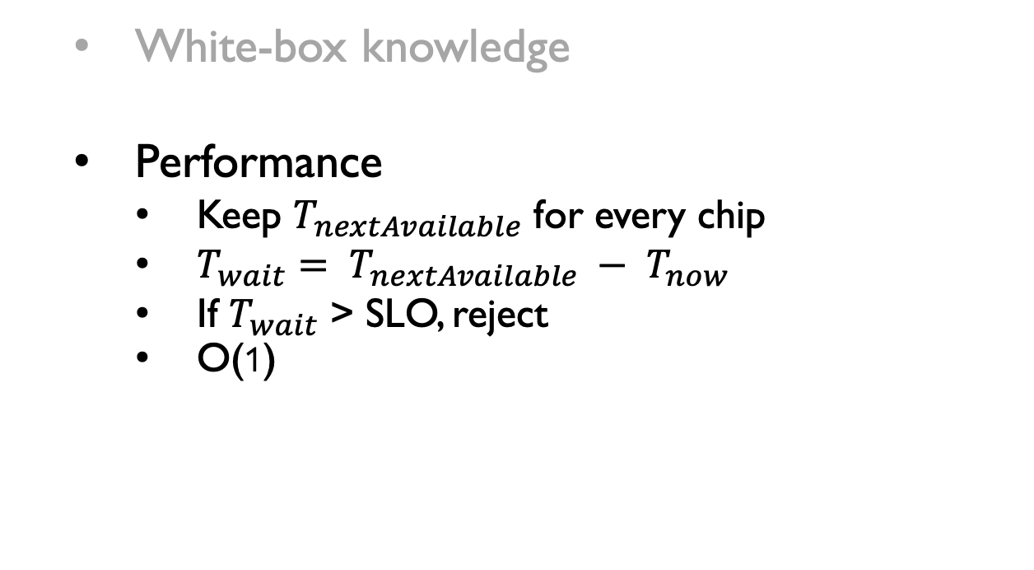
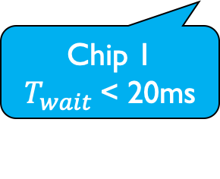
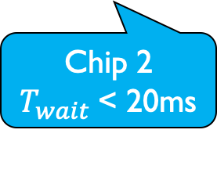
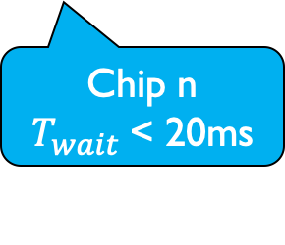
MittSSD
White-box knowledge
Performance
Keep $T_{nextAvailable}$ for every chip
$T_{wait}= T_{nextAvailable} − T_{now}$
If $T_{wait}$ > SLO, reject
O(1)
Parallel channels & chips
FIFO
< 20ms
Accept
…
Chip 1 $T_{wait}$< 20ms
Chip 2
$T_{wait}$< 20ms
Chip n $T_{wait}$< 20ms

Slide 23
MittSSD
White-box knowledge
Performance
Accuracy
Know the chip-level read/write latency
Write latency variability
MLC: Multiple level cell
pages
pages
pages
pages
1ms
2ms
1ms
Lower MLC bits
Pages
1ms
2ms
1ms
Upper MLC bits
2ms

Slide 24
Outline
Background
Design
Evaluation
Performance
Accuracy
Conclusion

Slide 25
Performance
Metric:
CDF of all get()
requests latencies
(total 6 million
data points)
Remote YCSB
client #1
…
Client #2
Client #20
Can failover
get()
get()
get()
3 replicas
…
Noisy neighbors based on EC2 data
Physical node #1
Node #2
Node #20

Slide 26
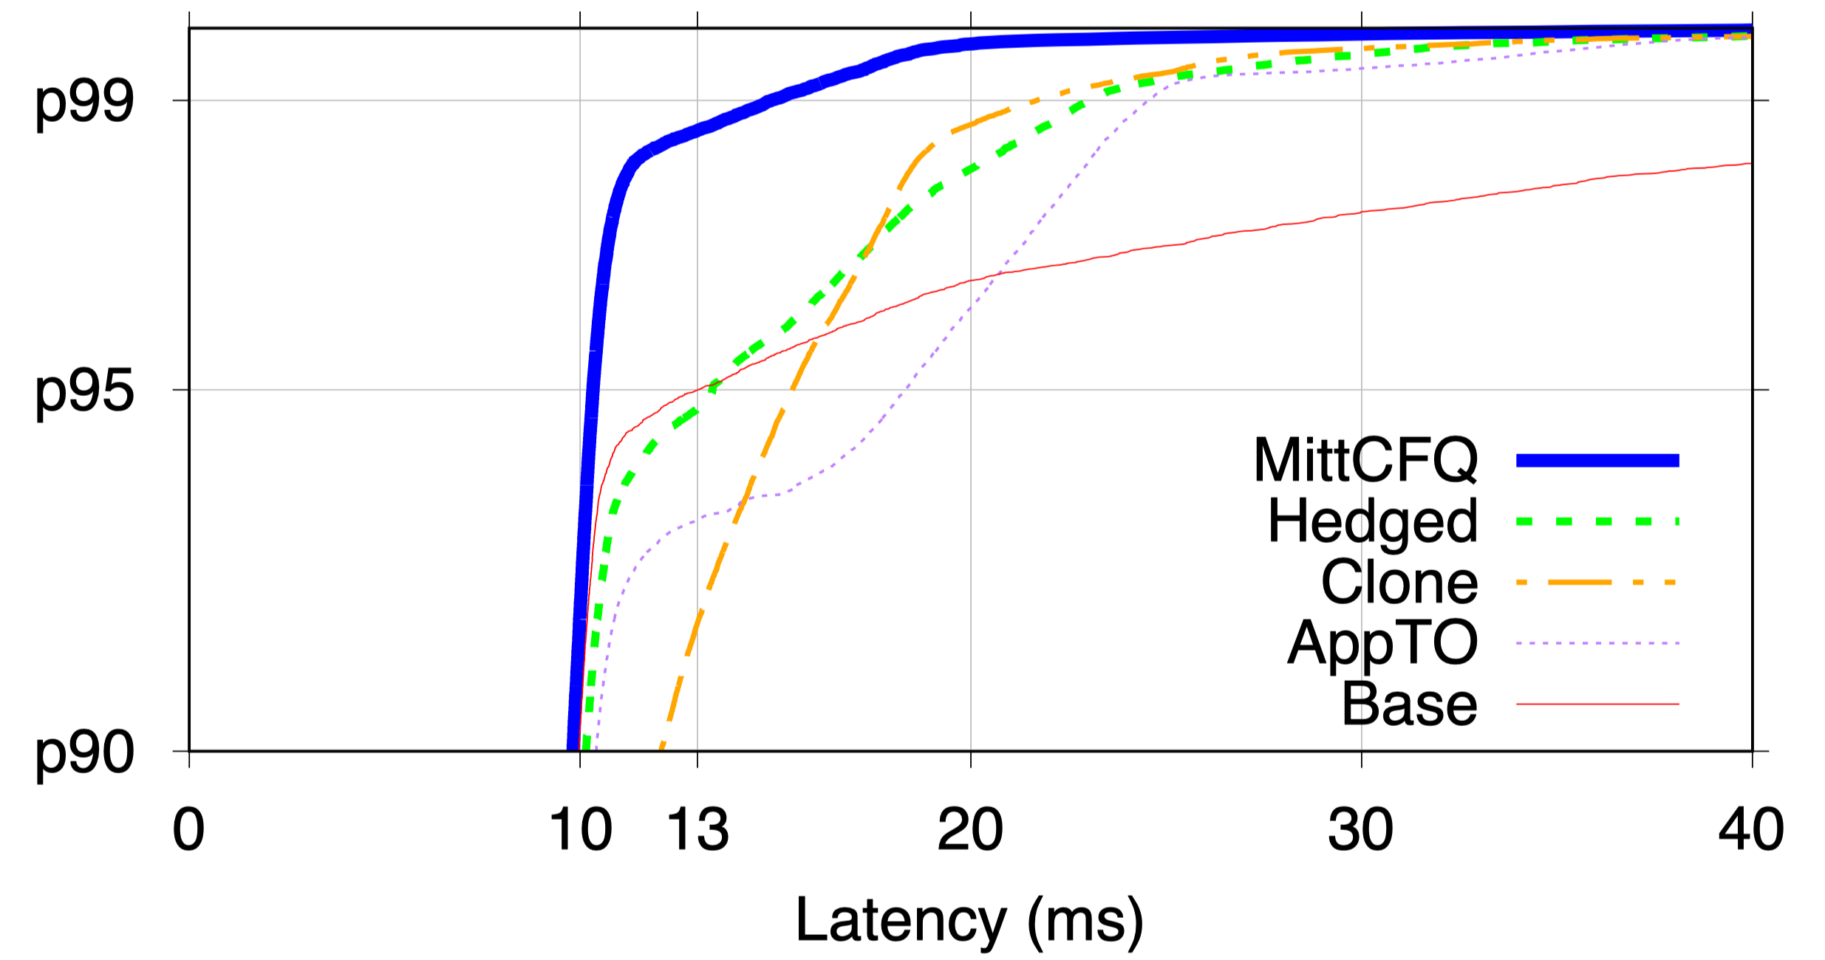
Hedged
Performance
(b) Waits for 13ms timeout
(a) Sends first request
CDF of YCSB get() Latencies on 20-node MongoDB
(d) Picks faster response
Cut tail latency
(c) Sends secondary request
95 percent
AppTO
App timeout
Similar to Hedged
Clone
Introduces more
than 2x workloads
90 percent

Slide 27
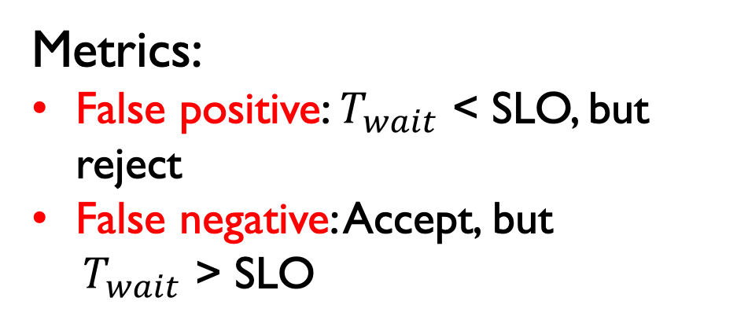
Accuracy Evaluation
MittCFQ
MittSSD
Metrics:
False positive: $T_{wait}$ < SLO, but reject
False negative: Accept, but
$T_{wait}$ > SLO
Disk
Open-Channel
SSD
5 real-world block-level traces
DAPPS
DTRS
TPCC
EXCH
LMBE

Slide 28
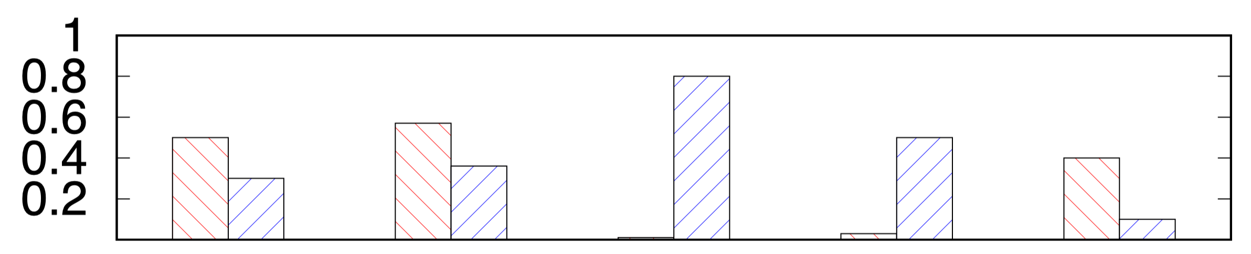
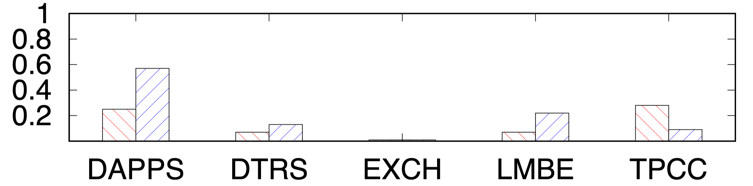
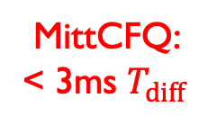
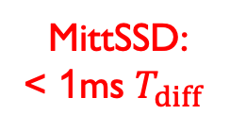
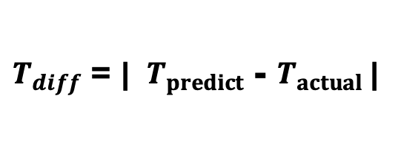
Among incorrect cases:
Accuracy Evaluation
MittCFQ:
< 3ms $T_{diff}$
MittSSD:
< 1ms $T_{diff}$
$T_{diff}$ = | ${ T}_{predict}$ - $T_{actual}$|
(a)
MittCFQ inacurracy(%)
(b)
MittSSD inacurracy(%)

Slide 29
Outline
Background
Design
Evaluation
Conclusion

Slide 30
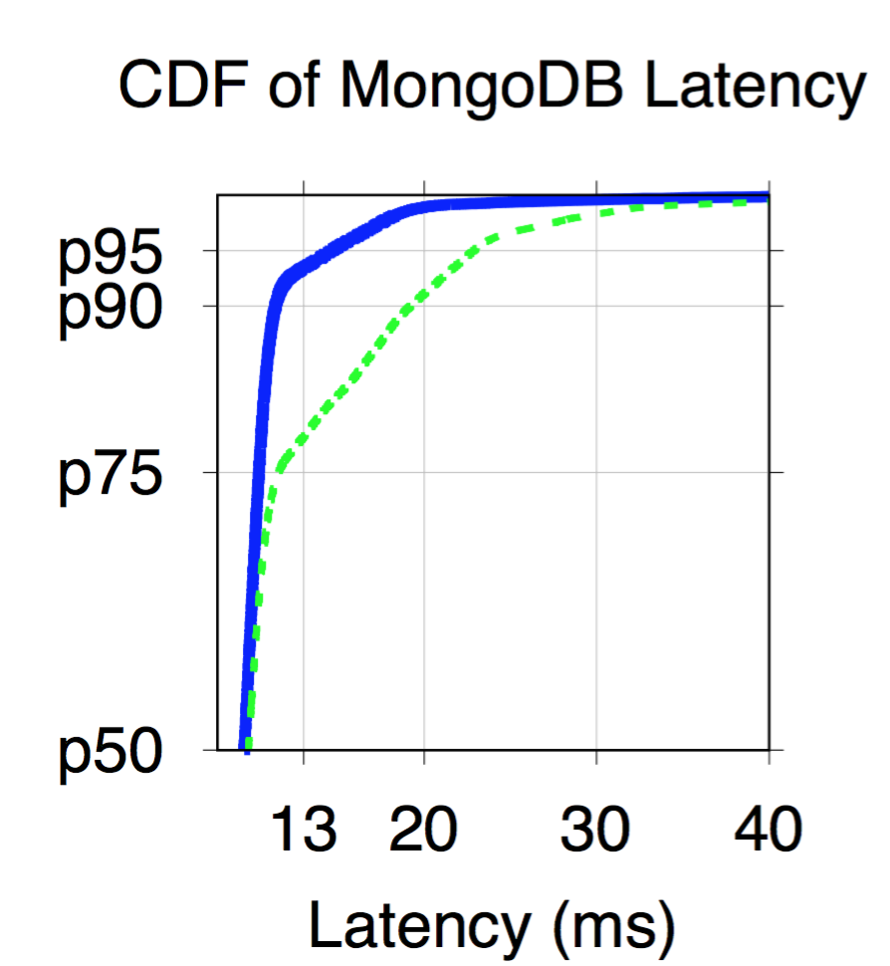


Conclusion
New philosophy
OS-level SLO awareness
Fast-rejection interface
Latency Predictions Mechanism
MittOS-powered apps
Cut millionsecond-level tail latencies
read(...) → read(..., SLO)
MittOS
State of art
CDF
Latency

Slide 31
Thanks & QA
New philosophy
OS-level SLO awareness
Fast-rejection interface
Latency Predictions Mechanism
MittOS-powered apps
Cut millionsecond-level tail latencies
read(...) → read(..., SLO)
MittOS
State of art
CDF
Latency

Slide 32


Slide 33
Backup

Slide 34
How to predict disk time
qTime: total seek cost of consecutive IO
Eg. FIFO Queue = {ABCD…}
qTime +=(seekCost(A, B)) + seekCost(B, C) + …);
freeTime += qTime;
seekCost(X, Y) =
seekCostPerGB * (Y.offsetInGB – X.offsetInGB) +
transferCostPerKB * X.sizeInKB;

Slide 35
For each interval in [ 100MB, 200MB, ..., 1GB ] do:
for (startOffset = 0; startOffset < maxOffset; startOffset += interval) {
for (endOffset = 0; endOffset < maxOffset; endOffset += interval) {
for (size = 0; size < maxSize; size += sizeInterval){
start_ts = gettimeofday();
seek (startOffset);
read (endOffset, size);
end_ts = gettimeofday();
latency = start_ts - end_ts;
print (endOffset - endOffset, size, latency);
}
}
}
MittCFQ Profiling
Random seek
Random read
Collect latency
scikit-learn
2 disk models
11-hour profiling
+ concurrent IO profiling
Latency
Linear Regression
Infer
Seek Distance
SSTF
scheduling
IO Size
1 million entries
(30MB memory overhead)
For 1TB drive
Accurate prediction

Slide 36
How to predict disk time
Disk will reorder its tasks order in its queue
If disk head position is currently near D
sstfTime += seekCost(D, C) + seekCost(C, B) + …);
Use linear regression to get the relationship

Slide 37
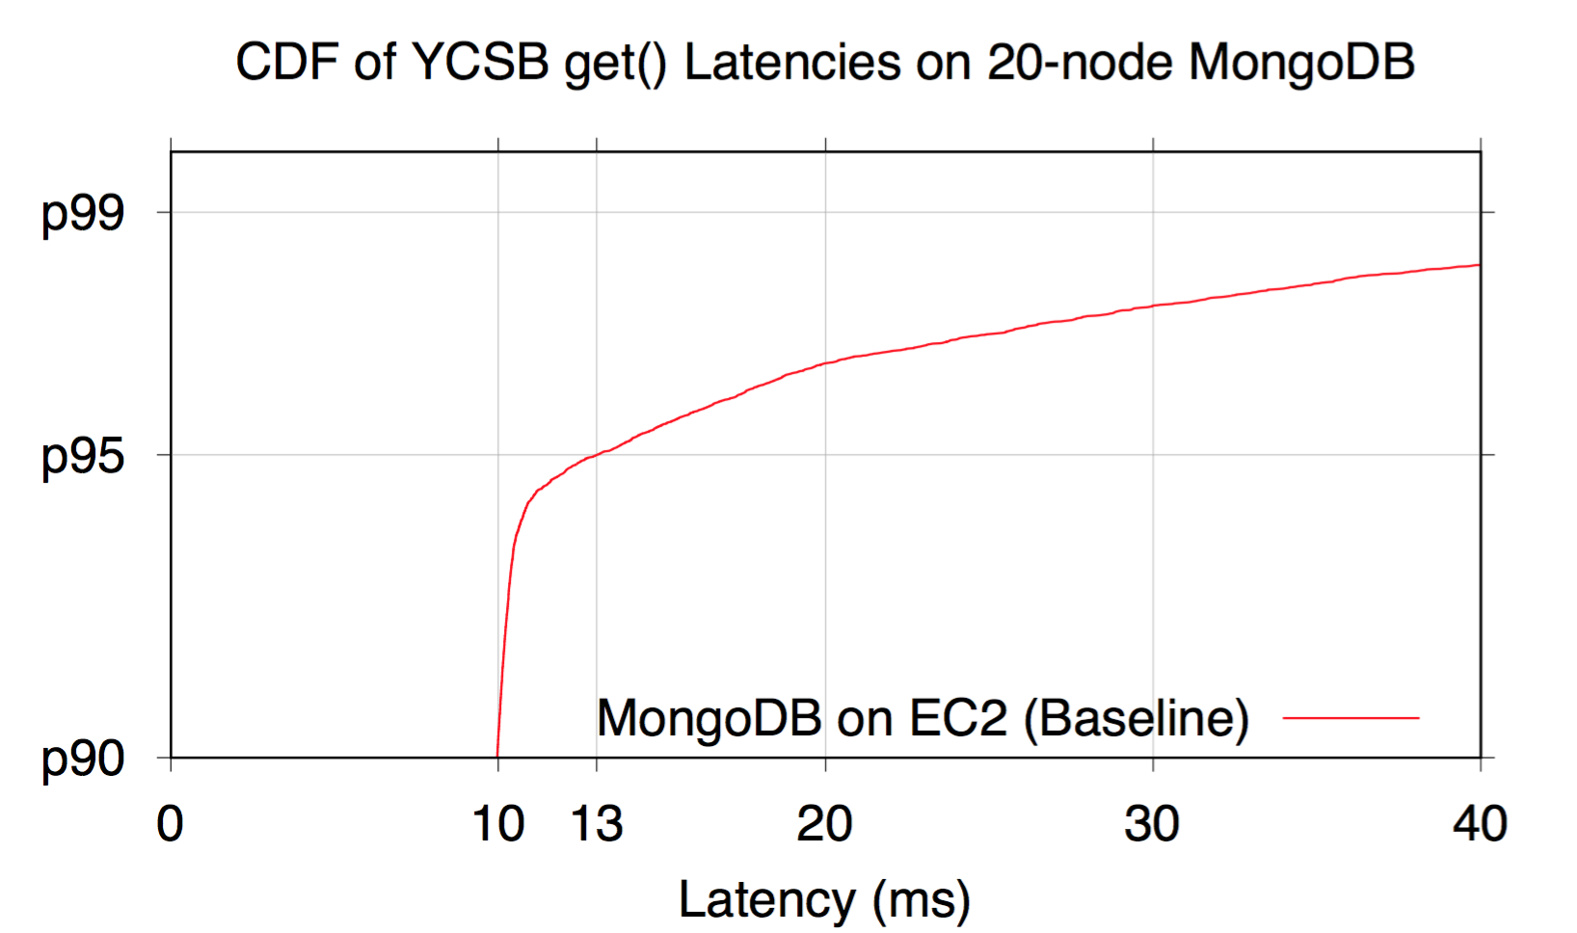
Baseline
Better!
13ms
at p95
> 40ms above p98
CDF (percentile)
90th percentile

Slide 38
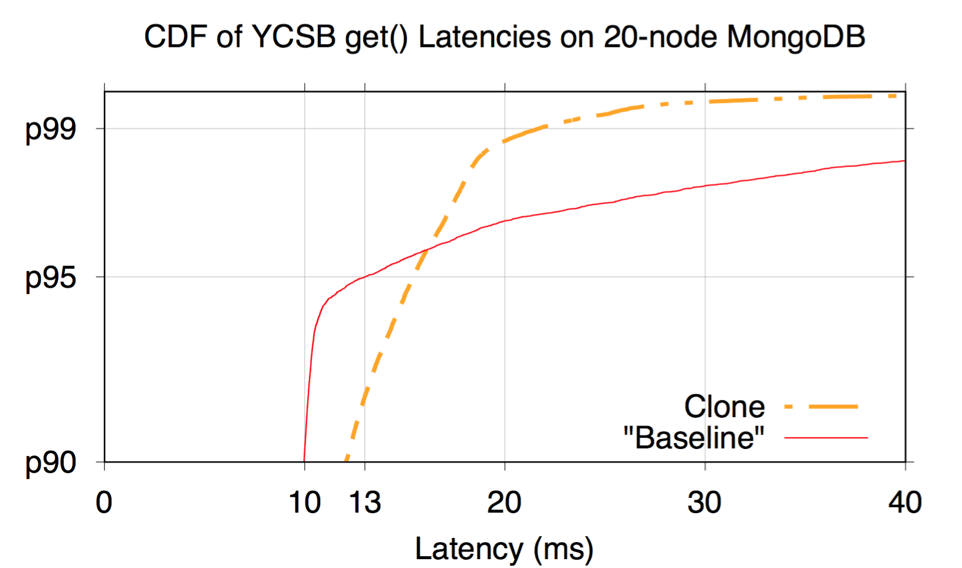
Clone VS Baseline
Clone
Introduces more than 2x workloads
Tail reduction
Worse performance < p95
90th percentile

Slide 39
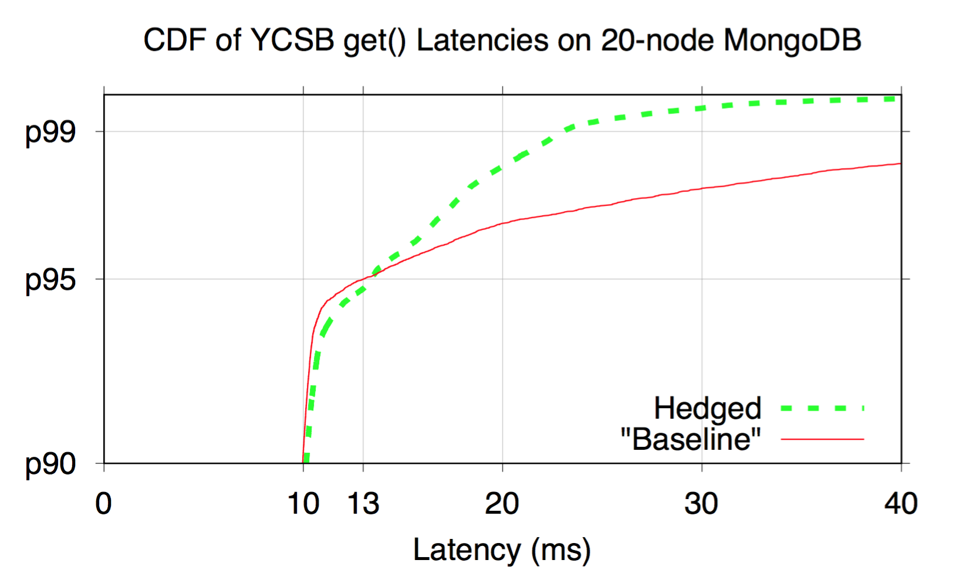
Hedged VS Baseline
(b) Waits for 13ms timeout
(a) Sends first request
Wait
Secondary
Tail reduction
(d) Picks faster response
Little extra workload
(c) Sends secondary request

Slide 40
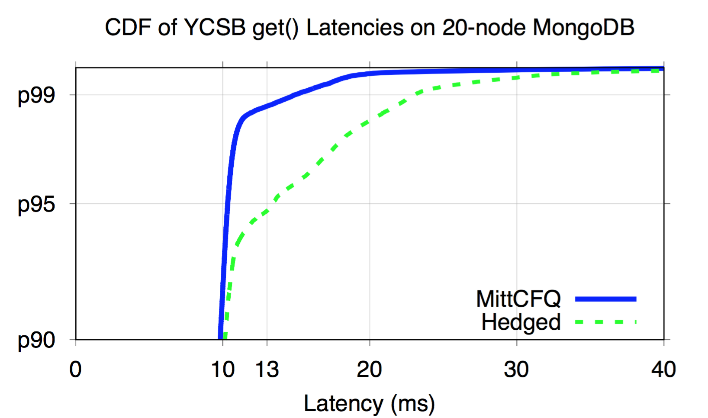
MittCFQ VS Hedged
Wait
Secondary
Failover
Cut ms tail!
Fast
reject
No-wait wins!

Slide 41

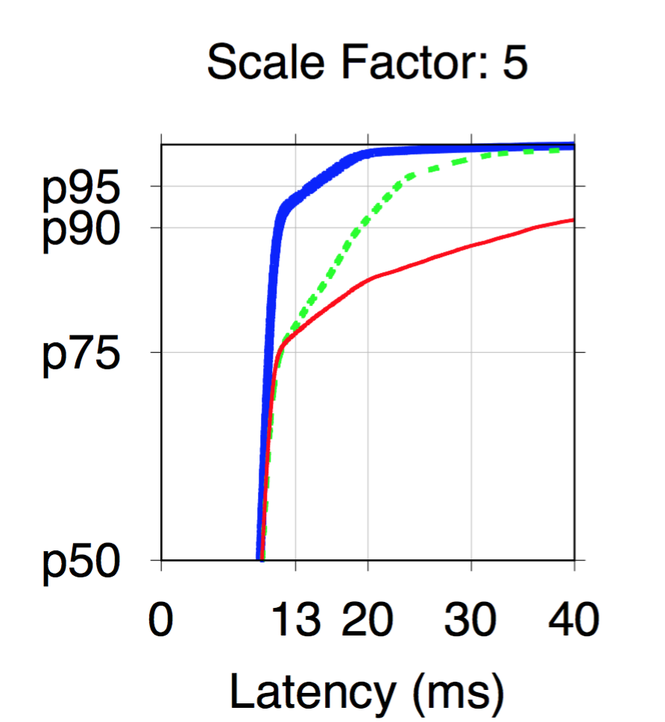
Tail amplified at Scale
S
Parallel
get() #1
MittCFQ
get() #2
Hedged
Base
…
Up to 2x speedup above p75
get()
#S
Tail amplified & more improvement space

Slide 42
